Slide 1
Topic Extraction with LDA & LSA
Team members: Daniel(Kun) Zhang, Jianning Qiao, Rimo Das

Slide 2

Agenda
Motivation
Problem Statement
Proposed Solution
Dataset
Implementation
Preliminary Observations
Results Evaluation
Challenges

Slide 3
Motivation
Knowledge-based economy
Timely access to information is vital
Explosion of digitized textual content
such as news
Information overload
Unstructured text

Slide 4
Problem Statement
Lessen information overload problem by focusing on main topics
Extract the main topics by unsupervised algorithm
in the news archive
Breaking news
Recommend relevant news by matching topics

Slide 5
Proposed Solution

Slide 6
Leverage text data algorithms like
Latent Dirichlet Allocation
and
Latent Semantic Analysis
to extract main topics of articles.

Slide 7


Dataset
Scraped 686 pieces of news from Cable News Network (http://cnn.com)
Downloaded articles from Wikipedia on 20180201

Slide 8
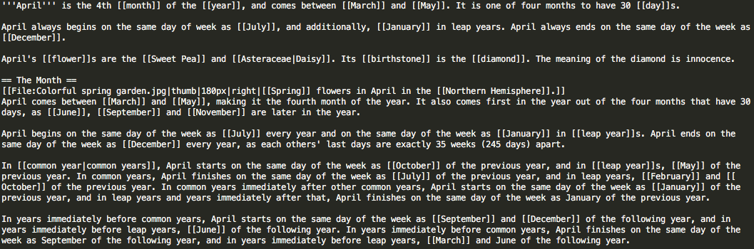
Dataset

Slide 9
Implementation
TF-IDF
&
Bag of Words
LDA
&
LSA
Select the Number of Topics

Slide 10
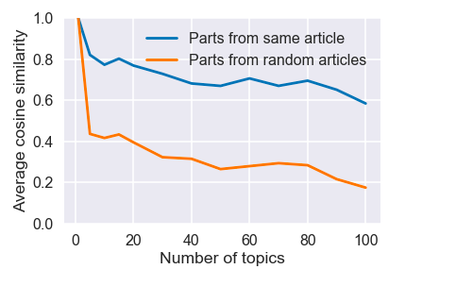
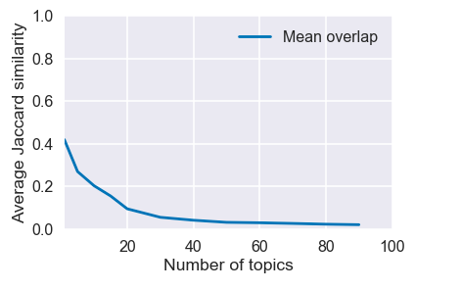
Preliminary Observations -- CNN
TF-IDF + LDA

Slide 11
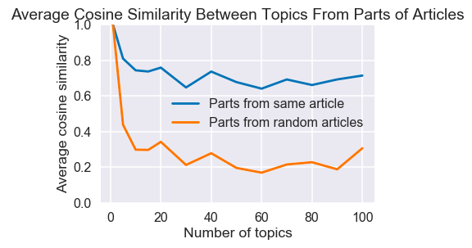
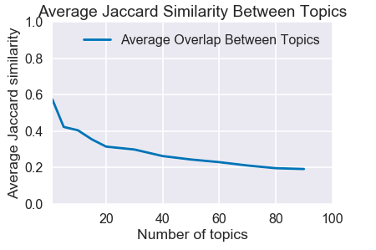
Preliminary Observations -- CNN
BAG OF WORDS + LDA

Slide 12
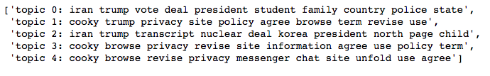
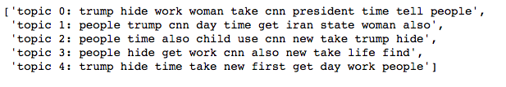
Result Evaluation -- CNN
TF-IDF + LDA
BAG OF WORDS + LDA

Slide 13
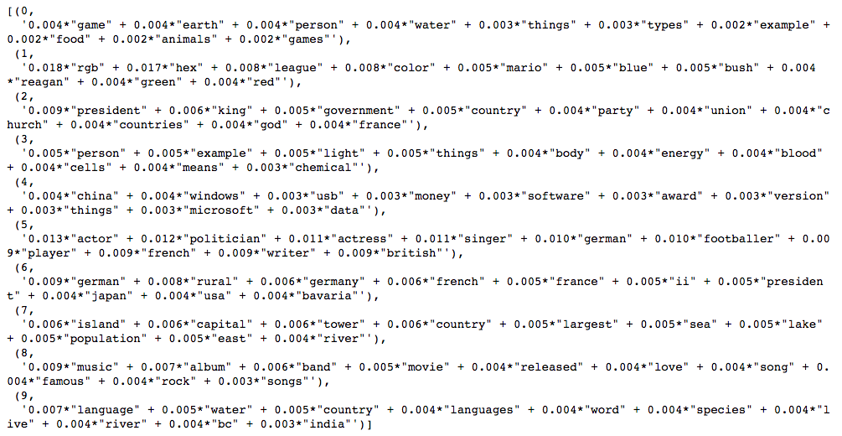
Preliminary Observations -- Wikipedia
BAG OF WORDS + LDA

Slide 14
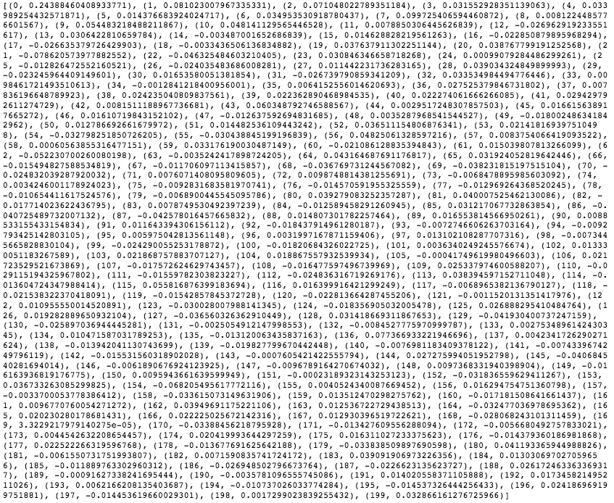
Preliminary Observations -- Wikipedia
TF-IDF + LSA

Slide 15
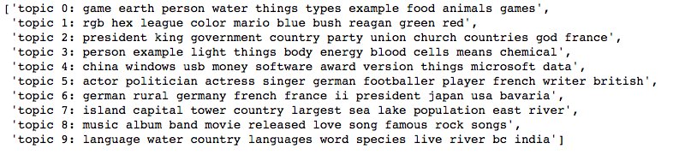
Result Evaluation -- Wikipedia
BAG OF WORDS + LDA

Slide 16
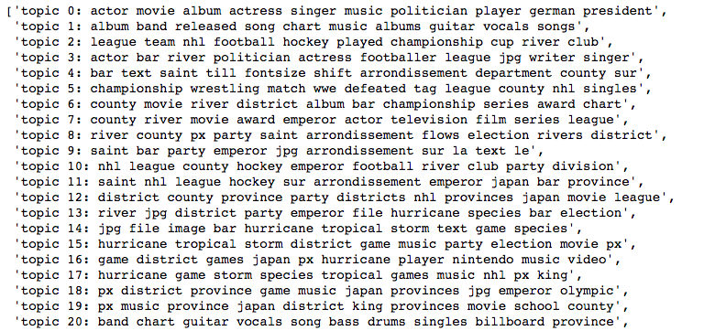
Result Evaluation -- Wikipedia
TF-IDF + LSA

Slide 17
Model Use Cases
Group Readers according to Reading History
Match topics with topic profile of each user group
Recommend news for different user groups

Slide 18
Challenges
Choose, evaluate and tweak topic modeling parameters
Evaluate topic models
no expected labels

Slide 19
Thanks!
Any questions?

